Slide 1
Starting with GITHUB
Installing git-hub user interface

Slide 2
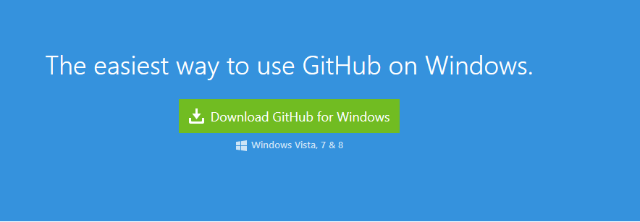

Download user interface Windows : windows.github.com Mac : Mac.github.com
Install it, After installation you’ll find two icons. The Gitshell is command line and Github is the user interface.
1.
2.

Slide 3
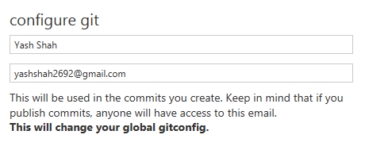
Open Github. Setup your username and email. (You also can set this up via the command line, we’ll see that too later)
Now go to www.github.com

Slide 4
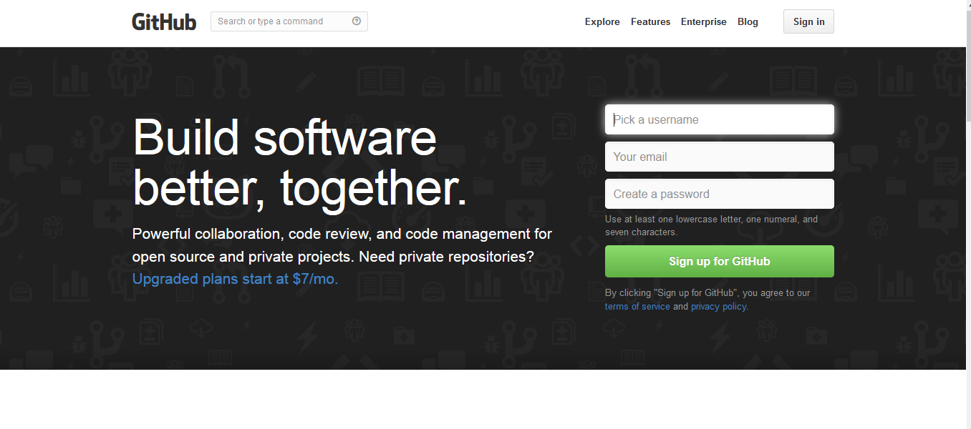
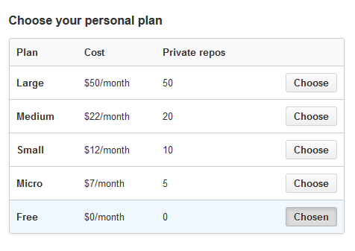
Enter you user details to create a new account.(Don’t worry it’s free !)
Check out the plans (If you want to select any other….)
1.
2.

Slide 5
You are all set to do some commands !

